Slide 1
Political Identification By Speech
Math 470:
Ciera Sherrill, Kristian Reed, Jasmin Jean-Louis
Final Presentation

Slide 2
Background

Slide 3
Political Layout
Economic
Environmental
Social
Political
Left
Center
Right
Leaders
Campaigns
Elections
Speeches
Notes:
Speeches, dialouges, formal speaking engagements by political leaders representing a political party.

Slide 4
New England Political Parties
Scottish National Party
Reform UK
Green Party
Labour
Conservatives
Democratic Unionist Party
Green Party of England and Whales
Liberal
Democrats
Left
Right
Center

Slide 5
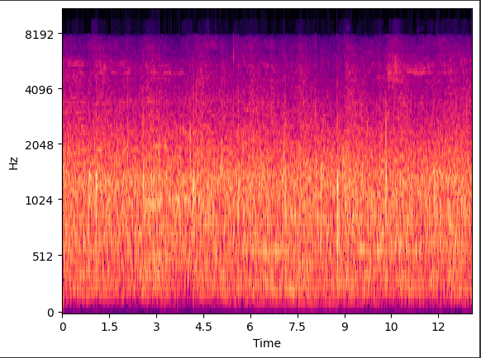
Mel Spectrogram
The way to process audio data
We do NOT focus on words/ focus on frequencies
Changes audio→ Waveform→ Spectrogram

Slide 6
Data & Code

Slide 7
Data Collection Process
Research Political Party Leaders in England
Center
Liberal Democrats
Labour
Conservative
Right
Democratic Unionist Party
Reform UK
Left
Green Party
Green Party of England and Wales
Ed Davey
Liz Truss
Keir Starmer
Wes Streeting
Boris Johnson
Suella Braveman
Ian Paisley Jr
Sir Jeffrey Donaldson
Richard Tice
Arlene Foster
John Prescott
Ann Widdecombe
Hugh Warwick
Jonathon Porritt
Natalie Bennett
Humza Yousaf

Slide 8
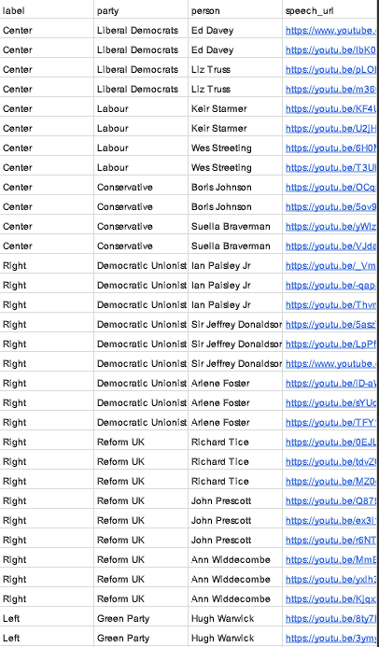


Data Collection Process
2. Political Speeches from each party member
YouTube
3. Spreadsheet to Video Links
Categorize and Store Data Videos
Convert to csv file on
4. Import Data into Colab Model

Slide 9
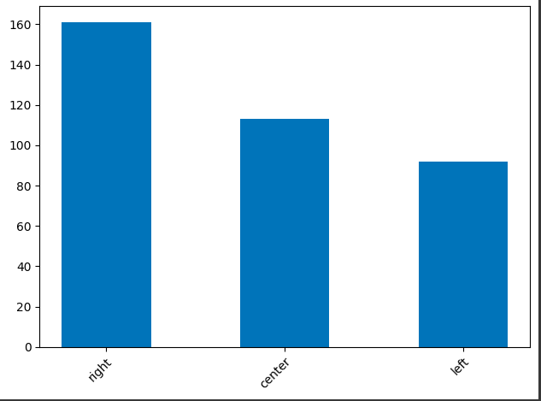
Data Collection

Slide 10
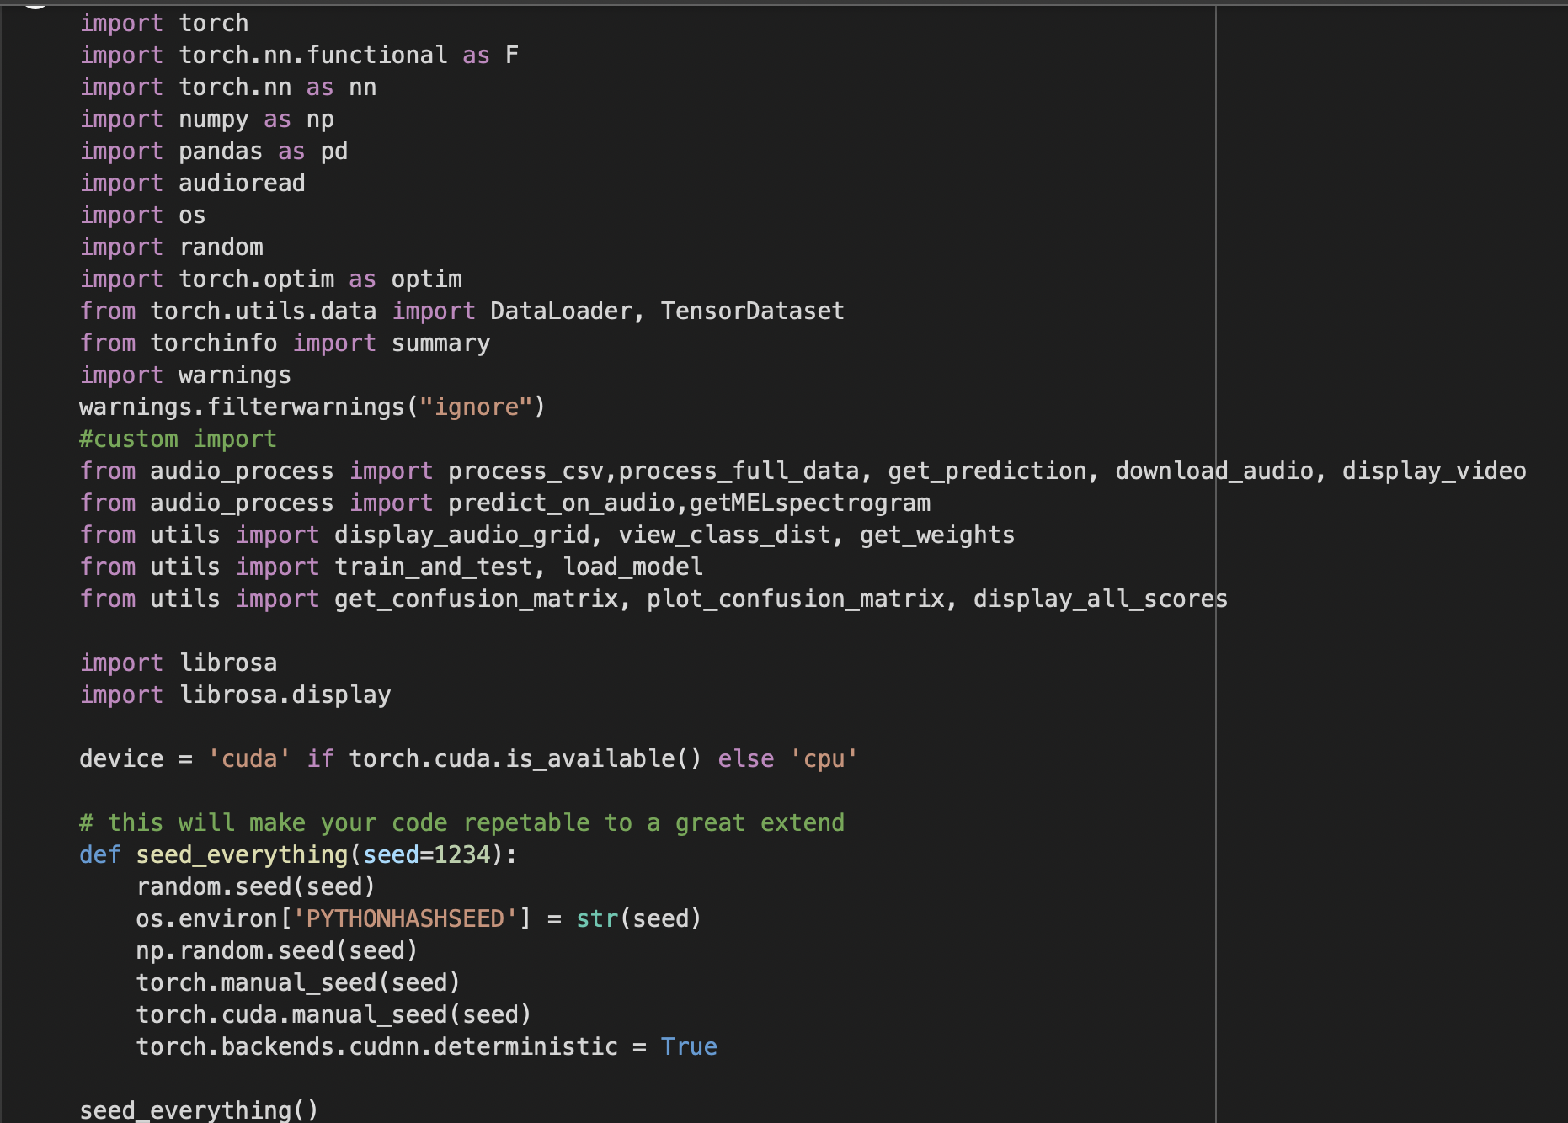
Code

Slide 11
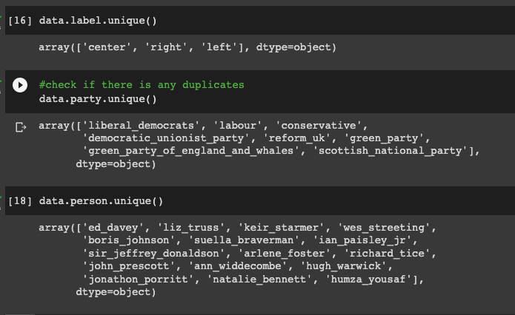
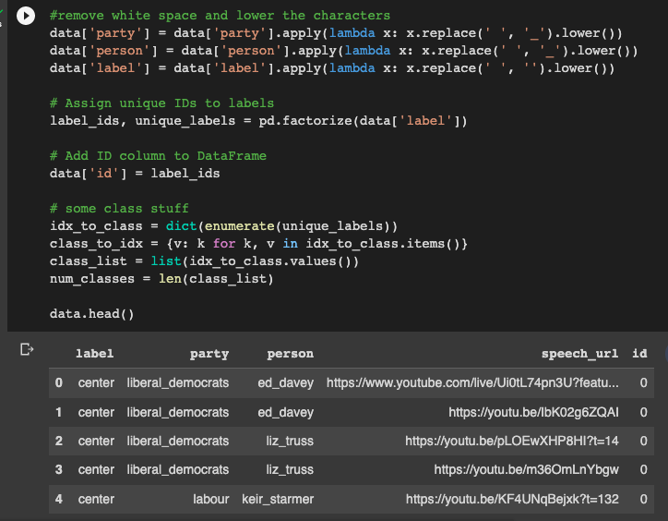
EDA for Audio
Notes:
Cleaning data for the model to read files and video links

Slide 12
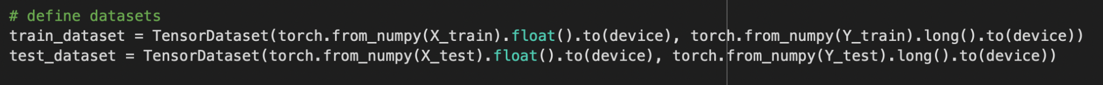
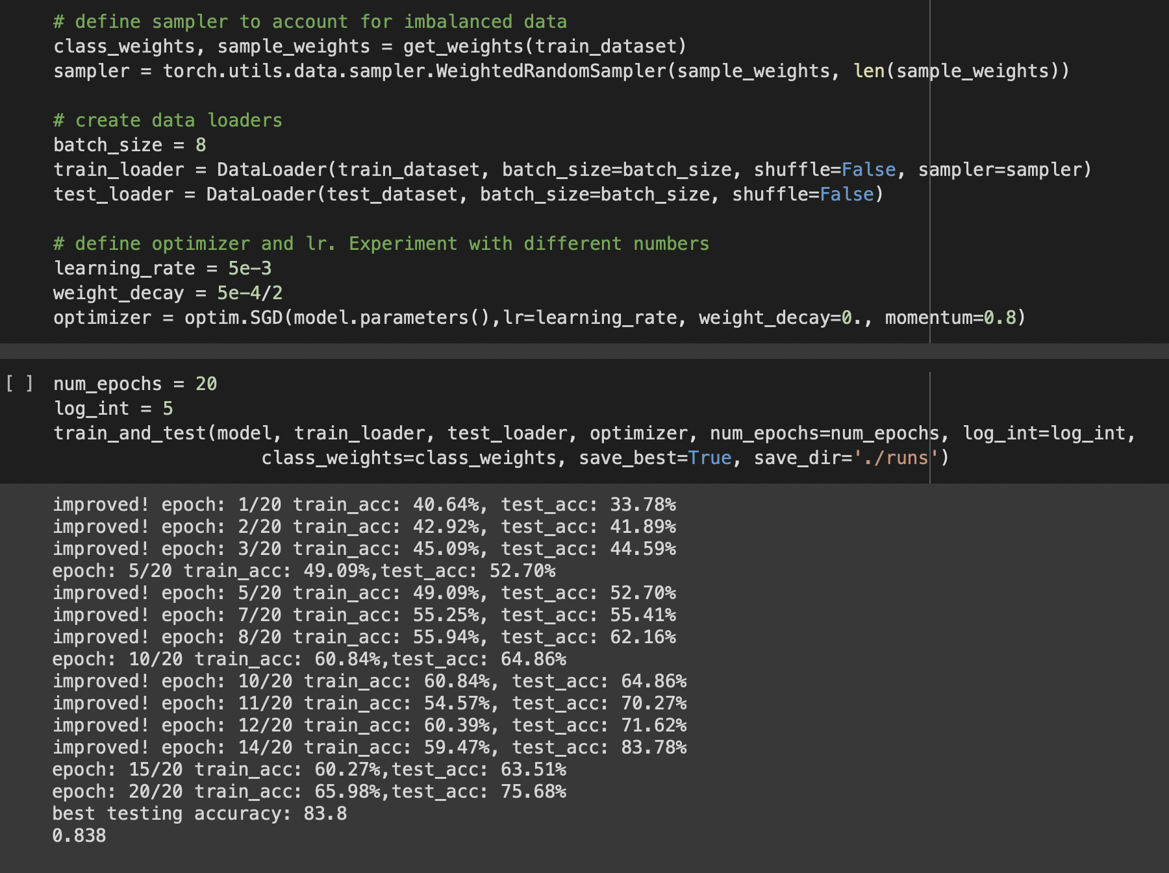
Train/ Test

Slide 13
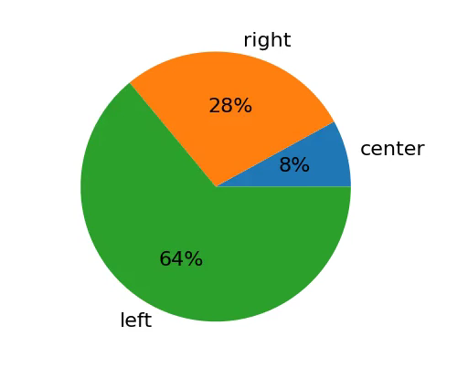
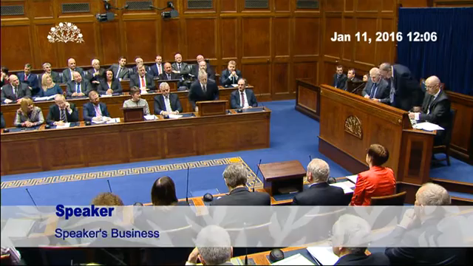


Slide 14
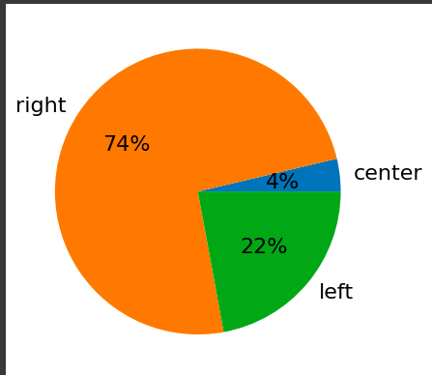
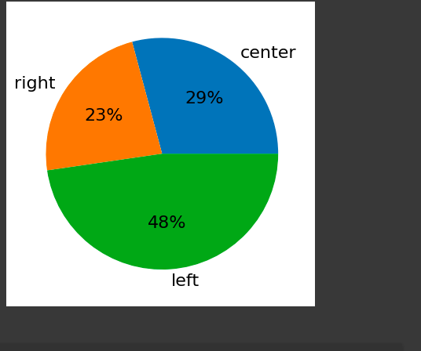
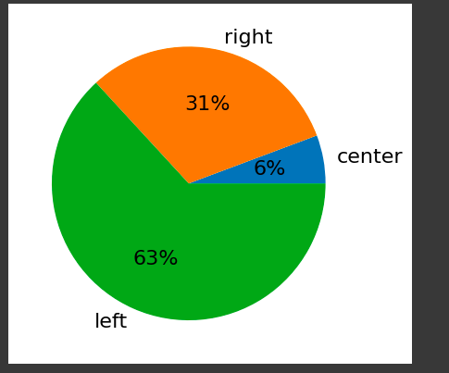
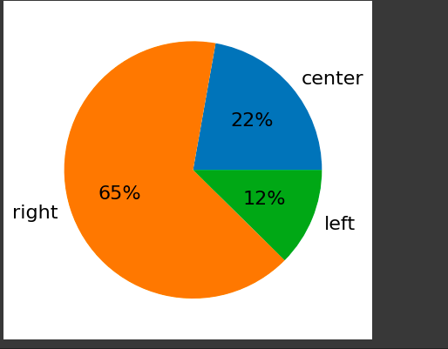
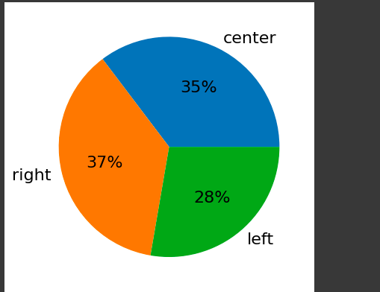
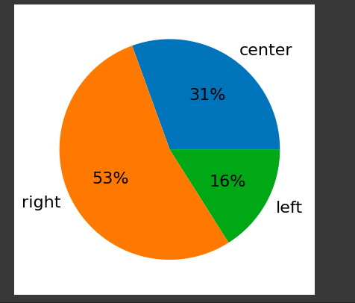
Pie Charts:
Center: Conservative: David Cameron
Right: Reform UK: Liz Truss
Left: Green Party: Annamie Paul

Slide 15
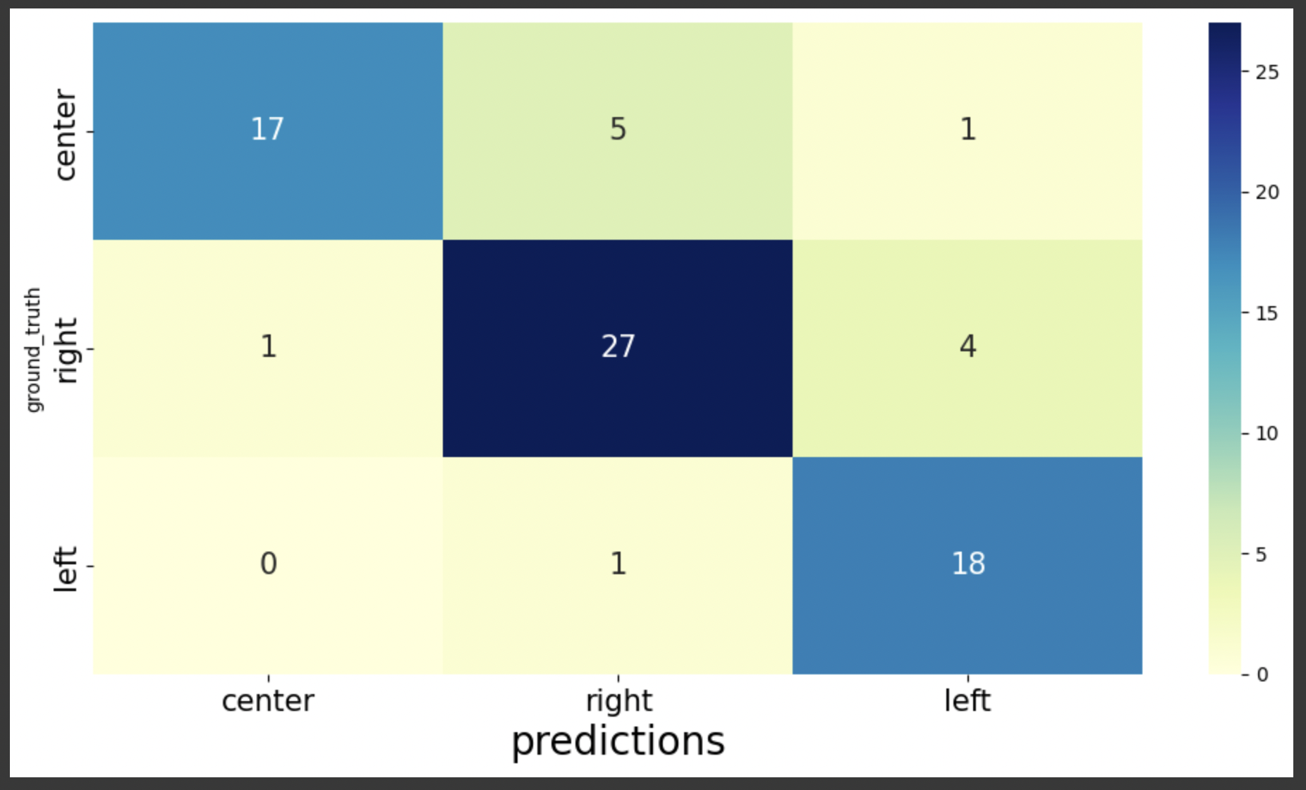
Results

Slide 16
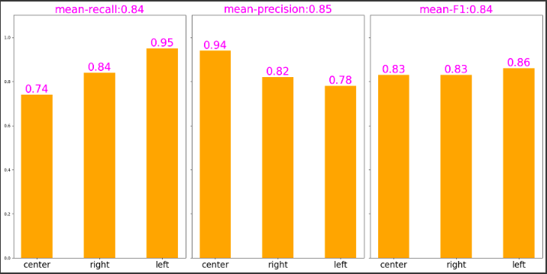
Results

Slide 17
Conclusion

Slide 18
Model Highlights and Struggles
Successful Model
Time Span of Speech Videos
Prediction of Center, Left, Right
Use in voting, campaign process with party classification of electoral speeches
Formatting of Videos/ Search Engines Errors
Code for Audio Translation to Classification
Speeches by Party Leaders on Common Topics

Slide 19
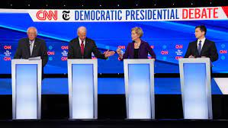
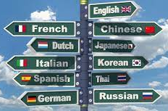
Futuristic Aspect
Global Expansion
Countries
Parties
Leaders
Political Debates
Conversation
Multiple Parties
Language Detection

Slide 20
Thank You!
Questions?

